Slide 1



Advance Transportation Management System
College Name : National Institute of Technology , Raipur
Problem Statement : 5
Presenter’s Name: Harsh Agrawal
Shivam Gupta
Raj Motwani
Anadi Agrawal
Team Name: The Cosmos
Agri
GO

Slide 2


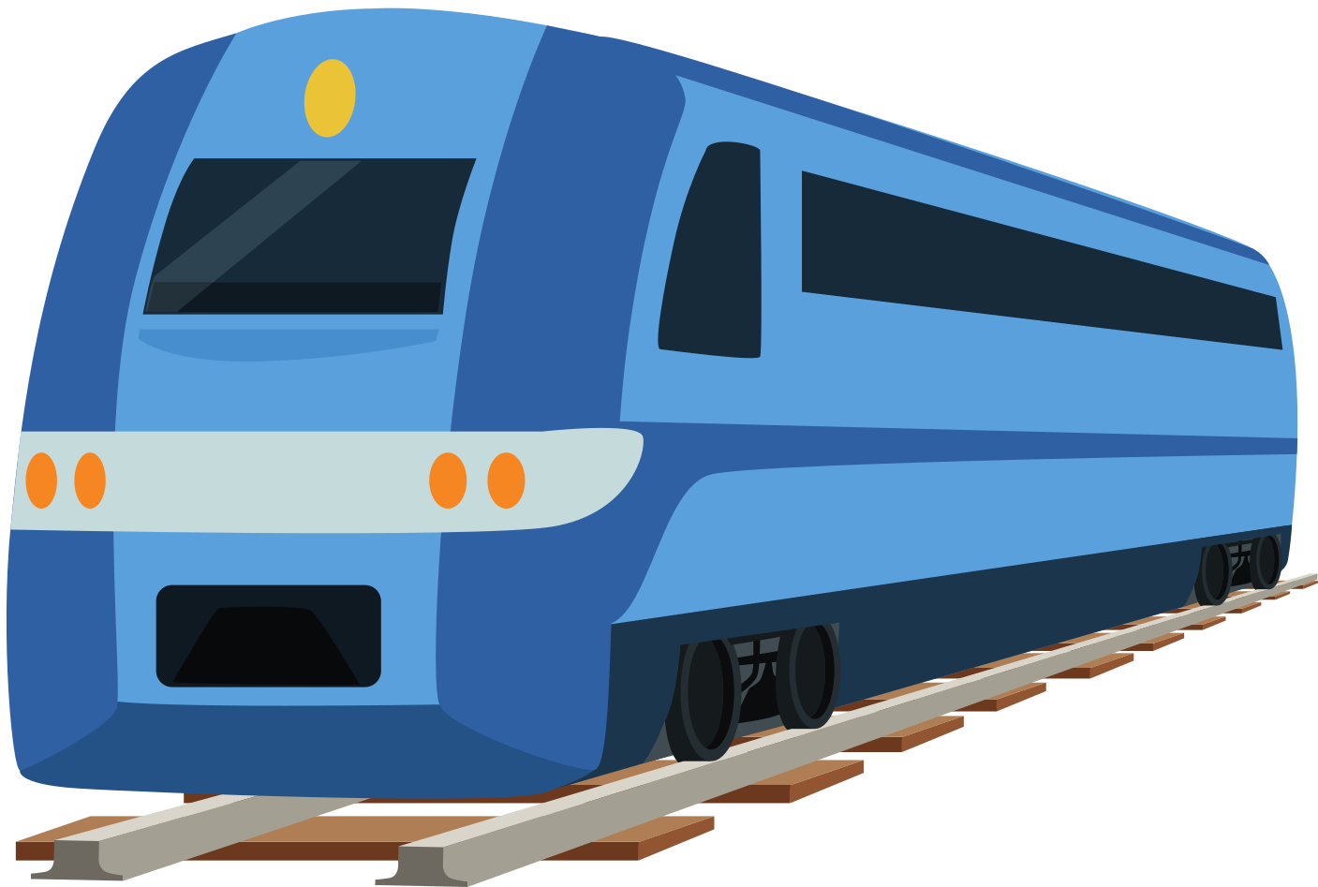
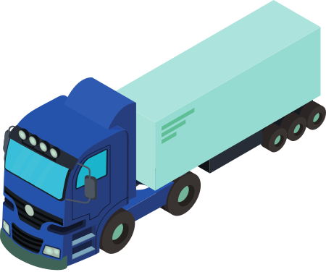
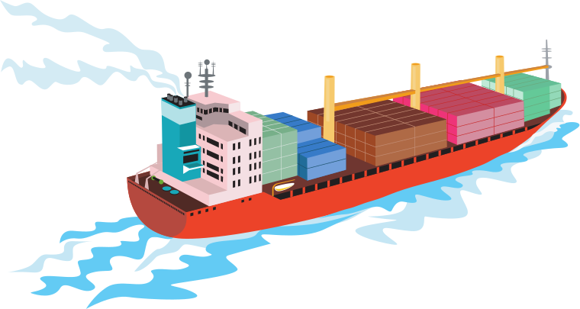
Problem Statement Explanation
Problem Statement Explanation
The Warehouses store different products and each of different quality and quantity and has a limit to the amount that can be stored in a specific quantity. At the same time there are distributors who need these products in specific amount but have less contact to different warehouses and find it difficult to compare their pricing and quality of the product. to connect them we have different transporters with their different rates and quality of service they provide but comparing them is difficult for the distributors and warehouse owners.AgriGo Platform: AgriGo connects warehouses, distributors, and transporters.
Solution:
Streamlined Process: Simplifies product ordering and transportation.
Transparency and Trust: Ensures transparent and trustworthy transactions.
Product Comparison: Allows distributors to compare pricing and quality.
Verified Transport: Reliable transporters for safe deliveries.
P5
P1 : Q1 _ Q2 _ Q3
P2 : Q1 _Q2
P3 : Q1 _ Q2 _ Q3
W1
D1
P1 & P3
P1 : Q1
P3 : Q1 _ Q2 _ Q3
P4: Q1 _Q2
W2
D2
P4
P2 : Q3
P4 : Q1 _ Q2 _ Q3
P5: Q1 _ Q2
W3
D3
Our Solution - AgriGo
With AgriGo distributer can have full control and make verified orders from the warehouse with assured quality and ratings from the previous orders, not just that he/she can have full access on the transportation of the product and track its location with quality service and insured goods via the transport.
Agri
GO

Slide 3
Working
CURRENT REPOSITORY
CURRENT ORDERS
PREVIOUS ORDERS
DYNAMIC BATCH DETAILS
PRICES
RATINGS
PRODUCTS
WAREHOUSES
Real-Time Tracking: All parties can track product transit with live location and driver details, allowing direct driver contact for coordination.
Product Insurance: Transporter-provided product insurance ensures reliability and reduces the risk of loss.
Feedback Incentives: A feedback system promotes good performance, rewarding with better orders and employment opportunities.
AgriGo's Recommendations: AgriGo suggests the best warehouses and transporters, estimating costs and delivery times for efficient ordering.
WAREHOUSE
DISTRIBUTER
AgriGo
TRANSPORTER
Distributor
(Selects the Order and gives payment)
Transporter
(Receives location, payment and details)
ALL in 1
EASY OPERATION
GREAT CONNECTIVITY
TRANSPARENT WORK
BUSINESS MODEL
WAREHOUSE
(Receives order, payment and
transporter details)
CURRENT ORDERS
DRIVER DETAILS
VEICHLE DETAILS
Check all the available warehouses, views the available products with their quality, quantity rating and pricing.
Selects the desired warehouse & product -> quantity -> location of delivery -> type of transportation makes payment
Receives the order details with pickup and drop location, the payment amount to be done after delivery, vehicle to be used (depending on the shelf life)
Confirms the order acceptance and gives the pickup time to the warehouse
Receives the order details with pickup timing and the payment to be received in after the pickup
Confirms the order acceptance and prepares the order for transportation.
Benefits
Transparent and Trustworthy Transactions.
Easy Product Comparison for Distributors.
Verified Transporters for Secure Deliveries.
Improved Efficiency
Cost-effective, reduced risk, and reliability.
Agri
GO

Slide 4










Benefits
1. Transparent and Trustworthy Transactions: AgriGo ensures transparency and trust within the agri-food supply chain. By connecting warehouses, distributors, and transporters, all transactions become more reliable. The platform verifies and validates all stakeholders, reducing the risk of fraud or misunderstandings. This increased trust fosters stronger business relationships and reduces the chances of disputes.
2. Easy Product Comparison for Distributors: Distributors benefit from AgriGo's user-friendly interface, which allows them to effortlessly compare product options. They can evaluate various factors, such as pricing, quality, and availability, helping them make informed decisions quickly. This streamlined process simplifies the procurement of goods, making it more efficient and cost-effective.
3. Verified Transporters for Secure Deliveries: One of the core advantages of AgriGo is the assurance of verified transporters. The platform rigorously screens and verifies transport service providers, ensuring the secure and timely delivery of goods. This reduces the risk of product damage, theft, or other transportation-related issues, making AgriGo a trusted choice for distributors.
4. Improved Efficiency: AgriGo's benefits translate into enhanced efficiency throughout the supply chain. Distributors can optimize their operations, reducing costs and risks. The platform's reliability and transparency offer a competitive edge, allowing all stakeholders to work together more seamlessly, ensuring the delivery of quality products.
Agri
GO

Slide 5
Conclusion
Challenges in Agri-Food Supply Chain:
Complex operations involving multiple stakeholders.
Varying transportation modes.
Changing environmental conditions.
Need for route optimization and cost reduction.
Lack of a specialized transportation management system.
AgriGo's Solution:
AgriGo connects warehouses, distributors, and transporters.
Simplifies product ordering and transportation.
Ensures transparent and trustworthy transactions.
Allows distributors to compare pricing and quality.
Provides reliable transporters for secure deliveries.
Key Features of AgriGo:
Real-time tracking and coordination for all parties.
Transporter-provided product insurance.
Feedback system incentivizing good performance.
AgriGo's recommendations for efficient ordering.
Additional Benefits:
Enhanced efficiency in the supply chain.
Secure and verified orders.
Product tracking and quality assurance.
Improved transparency and reduced risks.
Agri
GO
Team:
The Cosmos
Team Members:
Harsh Agrawal (Mechanical)
Raj Motwani(Mechanical)
Shivam Gupta (MME)
Anadi Agrawal( ECE)
Agri
GO

